Slide 1
Decoding Efficient Deep Learning: Path to Smaller, Faster, and Better Models
Research Paper: https://arxiv.org/pdf/2106.08962.pdf, Google Research, US
Presented by: Somya Mishra, San Jose State University

Slide 2
Why do we need Efficient deep learning?
Machine Learning and Artificial Intelligence at large is evolving at a tremendous pace!
Every researcher is trying to achieve the best models and beat benchmarks continuously.
When a model is deployed, a lot of focus must be spent on analyzing whether deep learning models can be efficiently scaled for people who might not have millions of dollars to train the models and gigantic machines to deploy their models.
How does one make efficiency related decisions?
Quality vs Footprint tradeoff

Slide 3
What are the challenges during model training and deploying?
Sustainable Server-Side Scaling
Enabling On-Device Deployment
Privacy & Data Sensitivity
New Applications
Explosion of Models

Slide 4
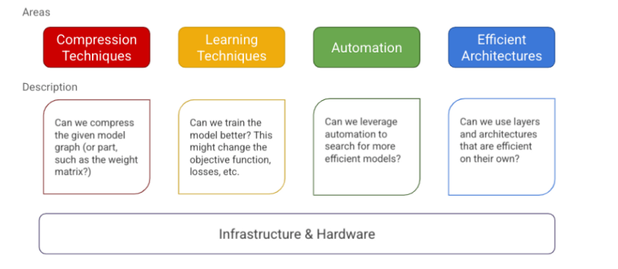
A Mental Model

Slide 5
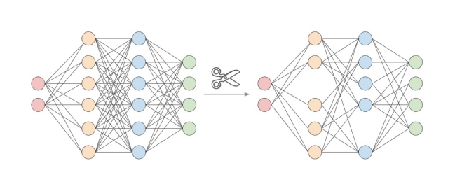
COMPRESSION TECHNIQUES
The goal is to see whether a big model can be converted to a small model , with the end goal being to be deployed on an edge device.
Quantization is a compression technique: reducing the weight metric of a layer by reducing its precision.

Slide 6
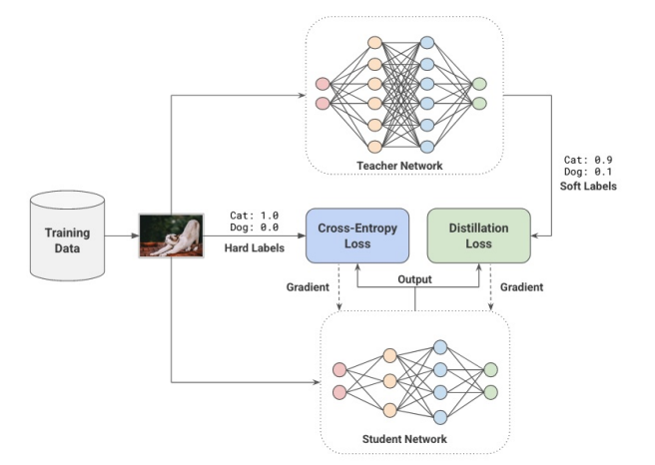
LEARNING TECHNIQUES
Can be considered as a replacement to traditional supervised learning algorithms.
The goal is to train a model differently to achieve better quality metric accuracy, F1 score, precision, recall, etc.
Achieve same baseline quality with a smaller model, with a trade off between quality and number of parameters / layers.

Slide 7
AUTOMATION
Tuning hyper parameters to improve accuracy, which could then be exchanged for a model with lesser parameters.
Train-test-split method can be used to initialize the parameters and observe the score/accuracy for each parameter.

Slide 8
EFFICIENT ARCHITECTURES
Basic building blocks that are designed from scratch such as convolutional layers and attention layers, that are a significant leap over the baseline methods used before.
Directly improve the efficiency gains.

Slide 9
infrastructure
Robust combination of good software and hardware
First step: Model training and second step: Model Inference
Hardware such as GPU and TPU can be used for speeding up linear algebra operations!

Slide 10
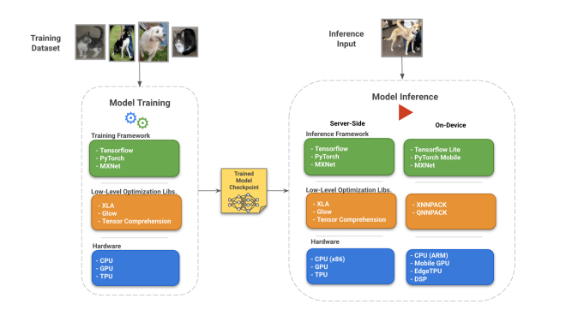
visualization of hardware and software infrastructure with emphasis on efficiency

Slide 11
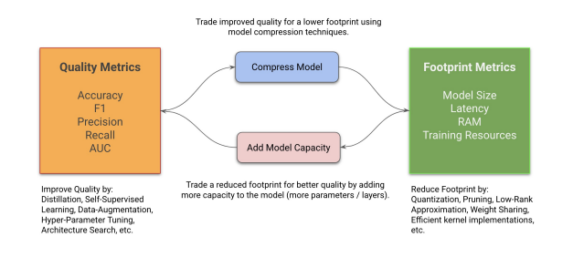
Practitioner’s guide to Efficiency: Trade off between Model Quality and Footprint

Slide 12
Shrink-and-Improve for Footprint-Sensitive Models
Grow-Improve-and-Shrink for Quality-Sensitive Models
Followed in cases where one wants to reduce the footprint and keep the quality the same for on-device deployments and server-side model optimization
Followed in cases where one wants to deploy models that have better quality while keeping the same footprint.

Slide 13
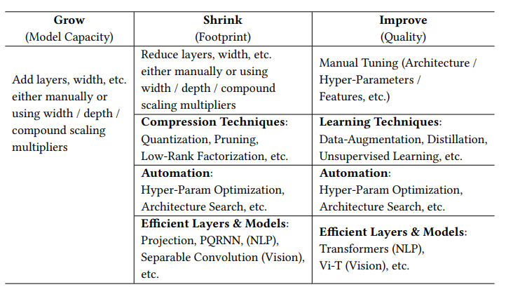
Examples of techniques to use in Grow, Shrink, and Improve phases:

Slide 14
CONCLUSION
First, we need to achieve a new pareto-frontier using the efficiency techniques.
Second, we demonstrate tradeoffs for both ‘Shrink-and-Improve’, and ‘Grow-Improve-and-Shrink’ strategies.
Last, we provide empirical evidence that it is possible to either reduce model capacity to bring down the footprint (shrink) and then recover the model quality that they traded off (improve) or increase the model capacity to improve quality (growing) followed by model compression (shrinking) to improve model footprint!

Slide 15
Reference
Menghani, G. (2021). Efficient Deep Learning: A Survey on Making Deep Learning Models Smaller, Faster, and Better. arXiv preprint arXiv:2106.08962.

Slide 16
THANK YOU!

